Slide 1
Lesson 18: Integral Process Characteristics
ET 438a Automatic Control Systems Technology

Slide 2
Learning Objectives
After this series of presentations you will be able to:
Describe typical process models found in control systems.
Write mathematical formulas for process models
Compute the parameters of process models.
Identify the Bode plots of typical process models.
Identify the time response of typical process models.

Slide 3
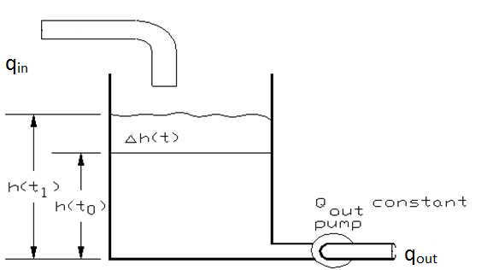
Integral Processes
Integral Process Characteristic - single energy storage element (capacitance) and no losses.
Example: Tank with constant output flow. (Pumped outflow)
For q_{in}>q_{out} h increases
For q_{out}>q_{in} h decreases
Pump maintains constant outflow regardless of tank height

Slide 4
Integral Processes
Mathematical Descriptions
Time domain equation:
Transfer function:
Where:
h(t₀) = normalized output at t₀ as percentage of FS_{out}
h(t₁) = normalized output at t₁ as percentage of FS_{out}
FS_{in} = full-scale input flow q_{in}
FS_{out} = full-scale output height h
T_{i} = integral action time constant
A = cross-sectional tank area (m²)
q_{in}(t) normalize input flow as % of FS_{in}.
q_{out}(t) normalize output flow as % of FS_{in}.
Integral Constant:

Slide 5
Integral Processes
Example 18-1: Find for the tank/pump system shown: a) the transfer function if the tank diameter is 1.5 m and the height is 4 m. Full scale q_{in} = 0.01 m³/s and full scale height is 4 m. b) determine the time domain equation and tank level after 100 seconds from t₀.
h(t₀)= 22.5% FS
q_{out} = 60% FS
q_{in} = 80% FS

Slide 6
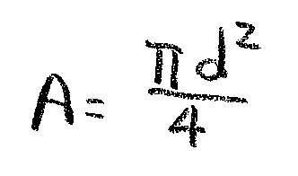
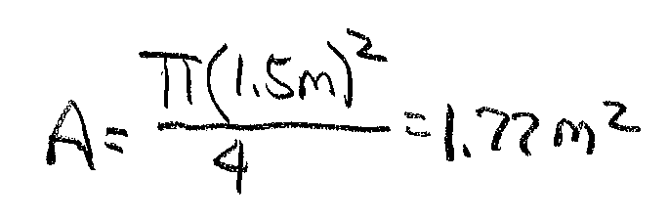
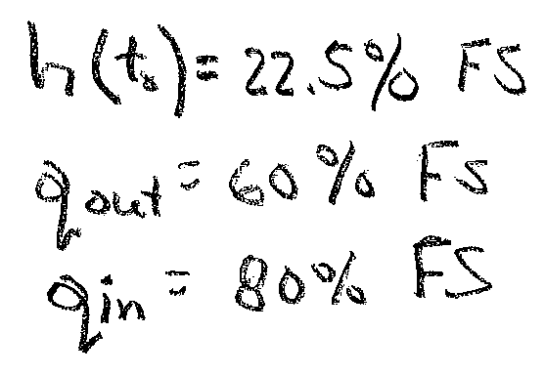
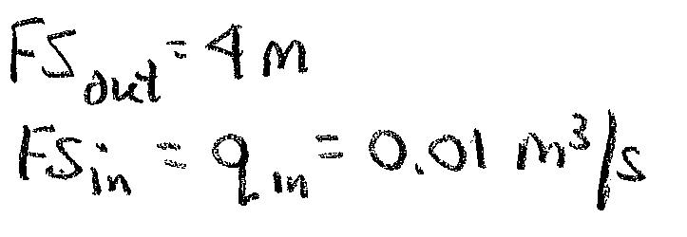
Example 18-1 Solution (1)
d=1.5 m

Slide 7
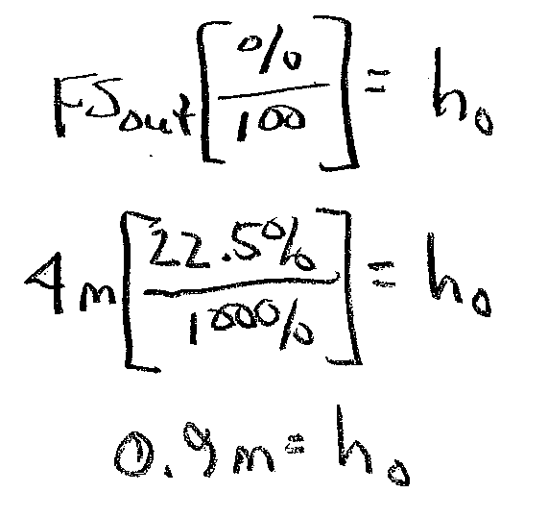
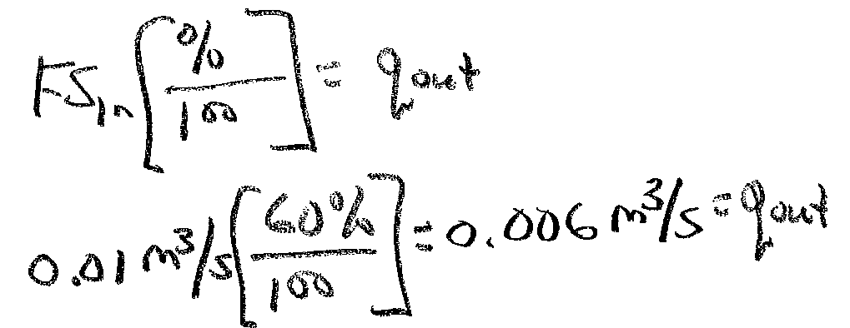
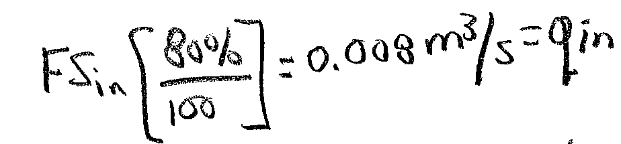
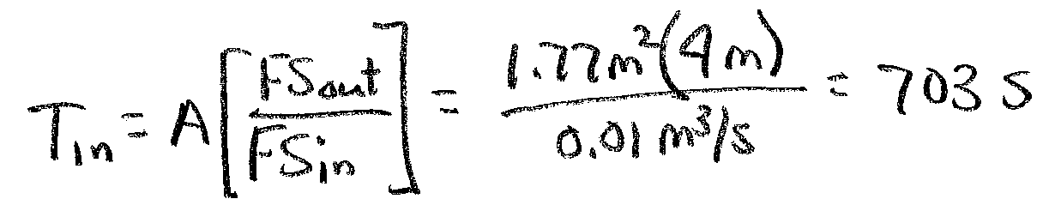
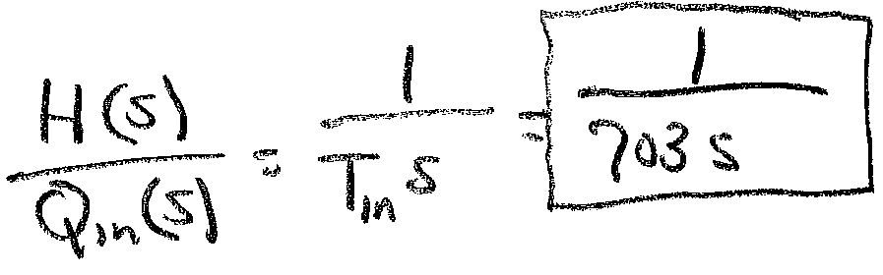
Example 18-1 Solution (2)
Convert flows and initial height into actual values from the given percentages
Ans a

Slide 8
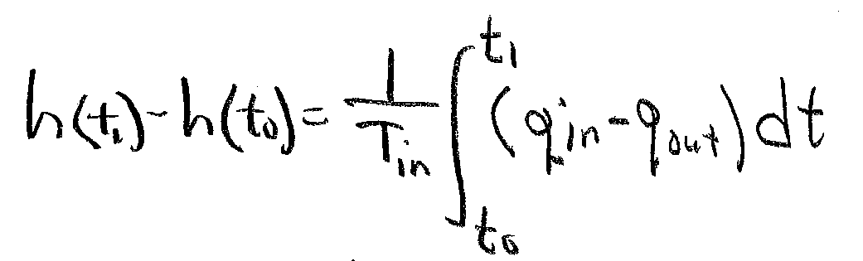
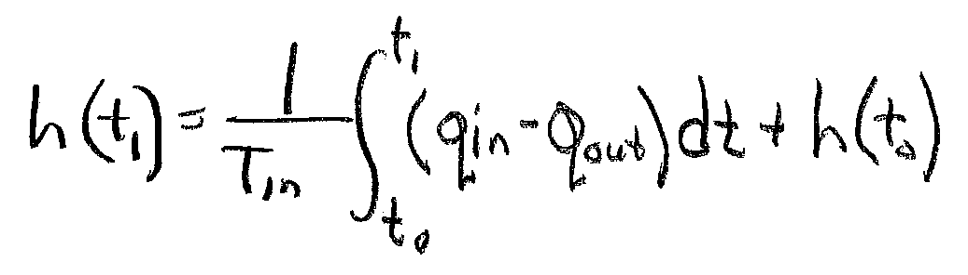
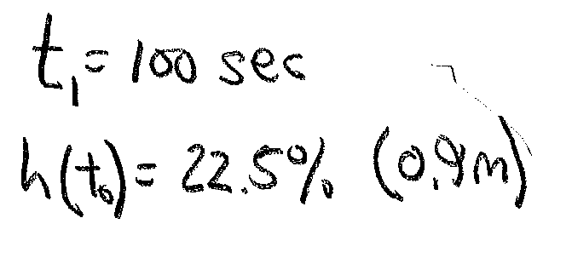
Example 18-1 Solution (3)
Now find the answer to part b. Use the equation from slide 4 for the integral
Solve for final
height
Assume t₀=0 start time

Slide 9
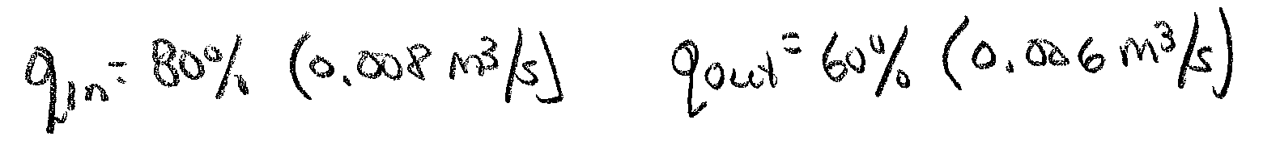

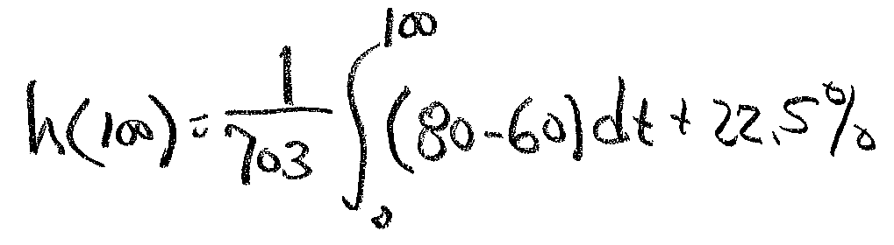
Example 18-1 Solution (4)
Calculation can be done using actual flow and height values of percentages. Use percentages in this case.
Place values in
this equation and integrate

Slide 10
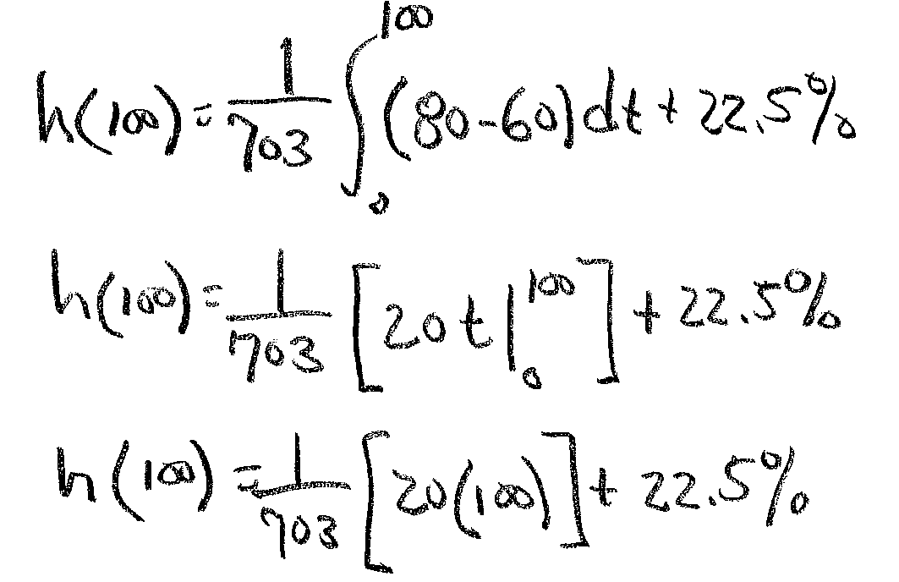


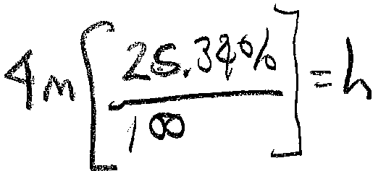

Example 18-1 Solution (5)
Integrate the difference between the flows.
Ans
Convert h% to meters:

Slide 11
Step Response and Bode Plots of The Integral Process
MatLAB Code
%close all previous figures and clear all variables
close all;
clear all;
%input the integral time constant
Ti=input('Enter the integral time constant: ');
% construct and display the system
sys=tf(1,[Ti 0]);
sys
%Plot the frequency response
bode(sys);
Grid on;
%Construct a new figure and plot the time response
figure;
%define a range of time
t=(0:15:Ti); %(start time, Stop time, final time)
% use this range to generate a step response
step(sys,t);
Grid on;

Slide 12
Integral Process Time Response
Integral response to step input (0-1) transition
Output reaches final value at value of T_{i}

Slide 13
Integral Process Frequency Response
Integrator has infinite gain to dc signals with decreasing response as frequency increases.
Gain decreases at a rate of -20 dB per decade
Constant phase shift of -90 degrees

Slide 14
End Lesson 18: Process Characteristics-Integral Process
ET 438a Automatic Control Systems Technology

